Slide 1

06/10/2020

Slide 2
5 – Software Design
Lab session 1

Slide 3
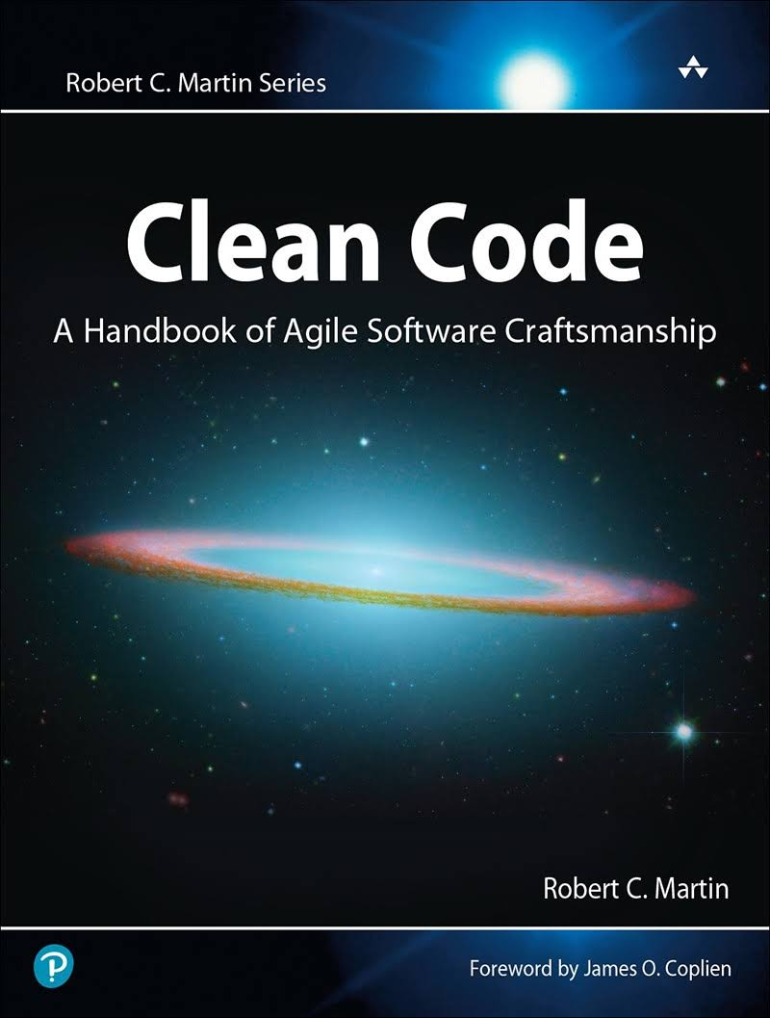
Goal
Clean & organised code
Many aspects to writing clean code Summary: https://gist.github.com/wojteklu/73c6914cc446146b8b533c0988cf8d29
Focus on diagrams & design patterns
How can code be structured in diagrams and vice versa?
How do we make use of design patterns, such that our code maintains clean, structured and reusable?
Even bad code can function. But if code isn’t clean, it can bring a development organization to its knees. Every year, countless hours and significant resources are lost because of poorly written code. But it doesn’t have to be that way
Clean Code – Robert “Uncle Bob” Martin

Slide 4
Outline labs
Part A: UML diagrams Sessions 1 – 2
Part B: Design Patterns Session 3 – 5
Part C: Projects in groups of 2 Session 6 – 9
Evaluation in January:
Entire portfolio: directories for each separate lab session, containing UML diagrams and code
Defence of projects

Slide 5
Initialisation
Installation & setup of tools

Slide 6


Environments
Programming
Java – JDK 8
Maven Plugin framework
Using JetBrains IntelliJ IDE https://www.jetbrains.com/idea/download/
UML Diagrams
Modelio https://www.modelio.org/downloads/download-modelio.html Make sure to read the requirements: https://www.modelio.org/downloads-links/requirements.html

Slide 7
Part A: UML Diagrams
Sequence & Use Case Diagrams

Slide 8
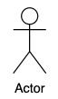

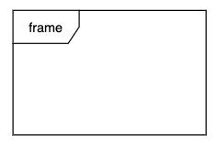
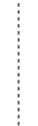
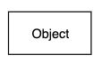
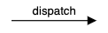
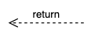
Sequence Diagrams
What?
Shows the interaction between objects/classes/components in a system Shows the order in which interactions take place
How?
Actor
Object
Lifeline
Activation box
Alternate frame
Messages

Slide 9
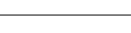
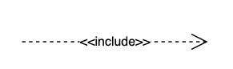
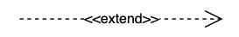
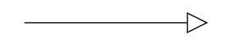
Use Case Diagrams
What?
Shows an overview of relations between the user and functionality
How?
Interaction environment
Relationships
Use Case

Slide 10
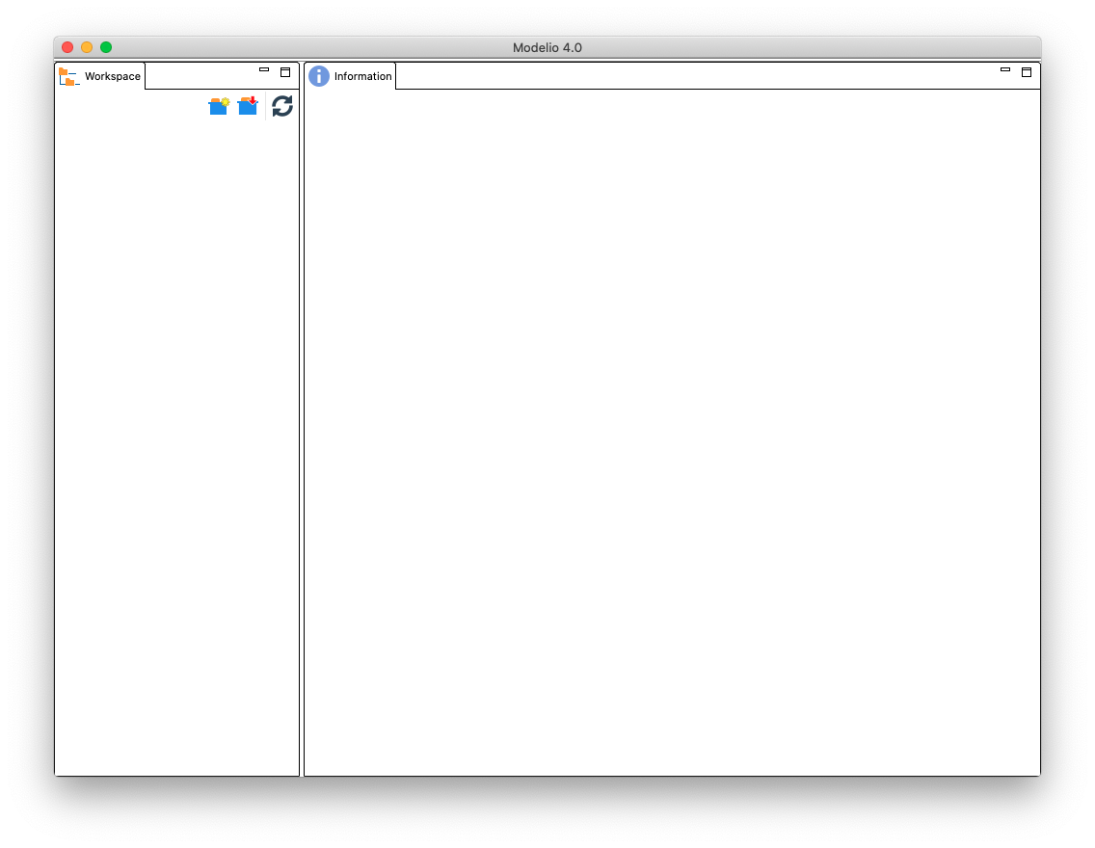
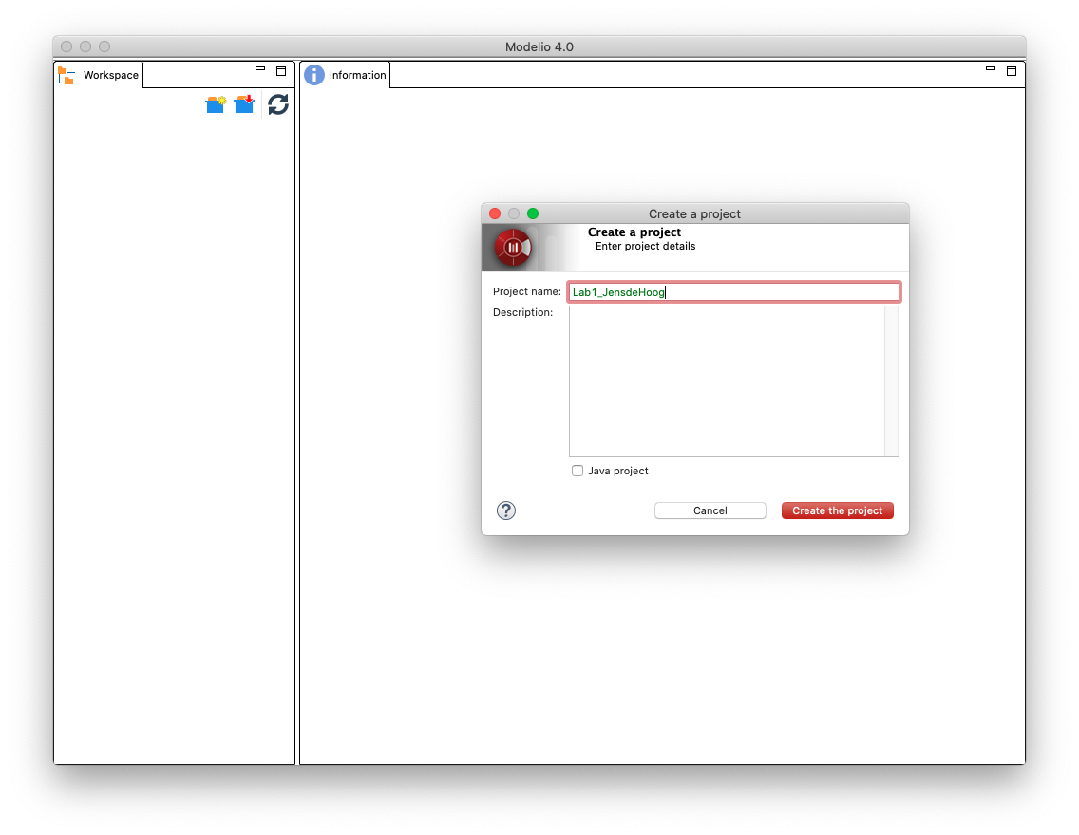
Usage of Modelio
Pick a clear project name LabX_FirstnameLastname

Slide 11
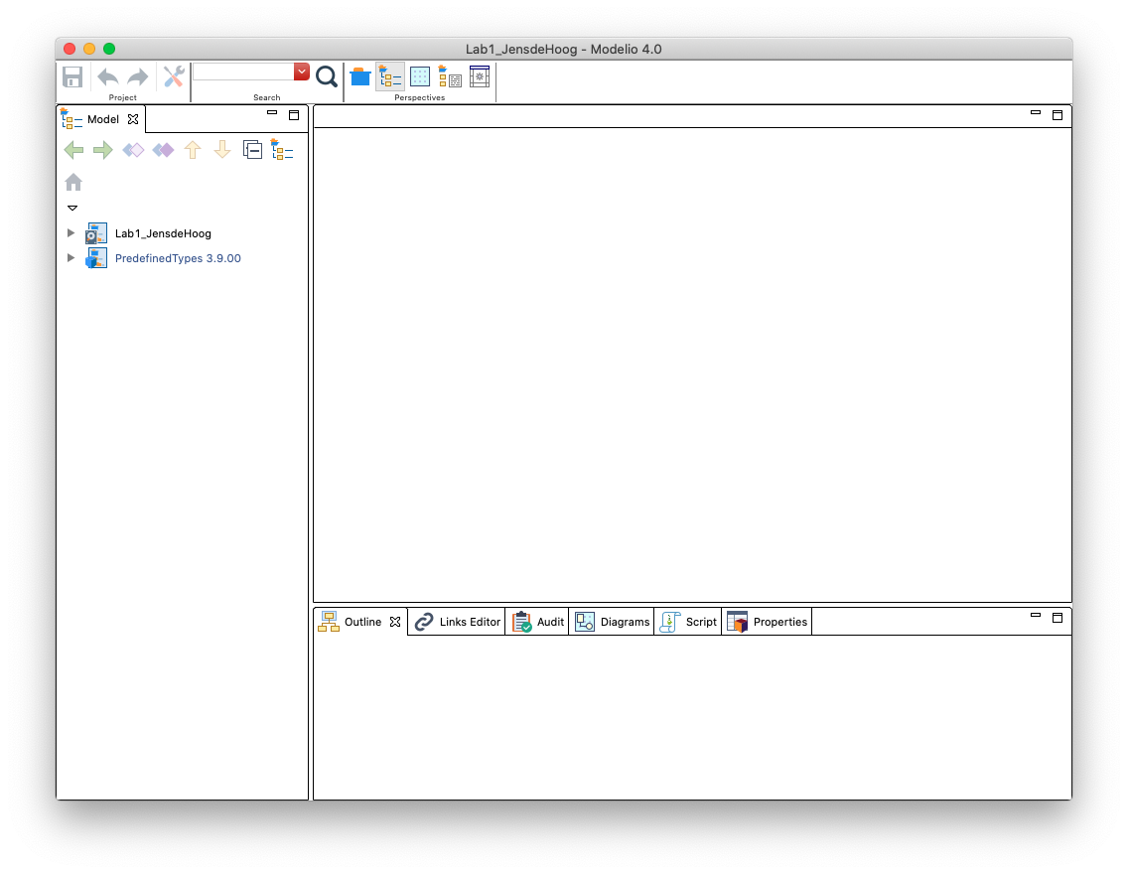
Usage of Modelio

Slide 12
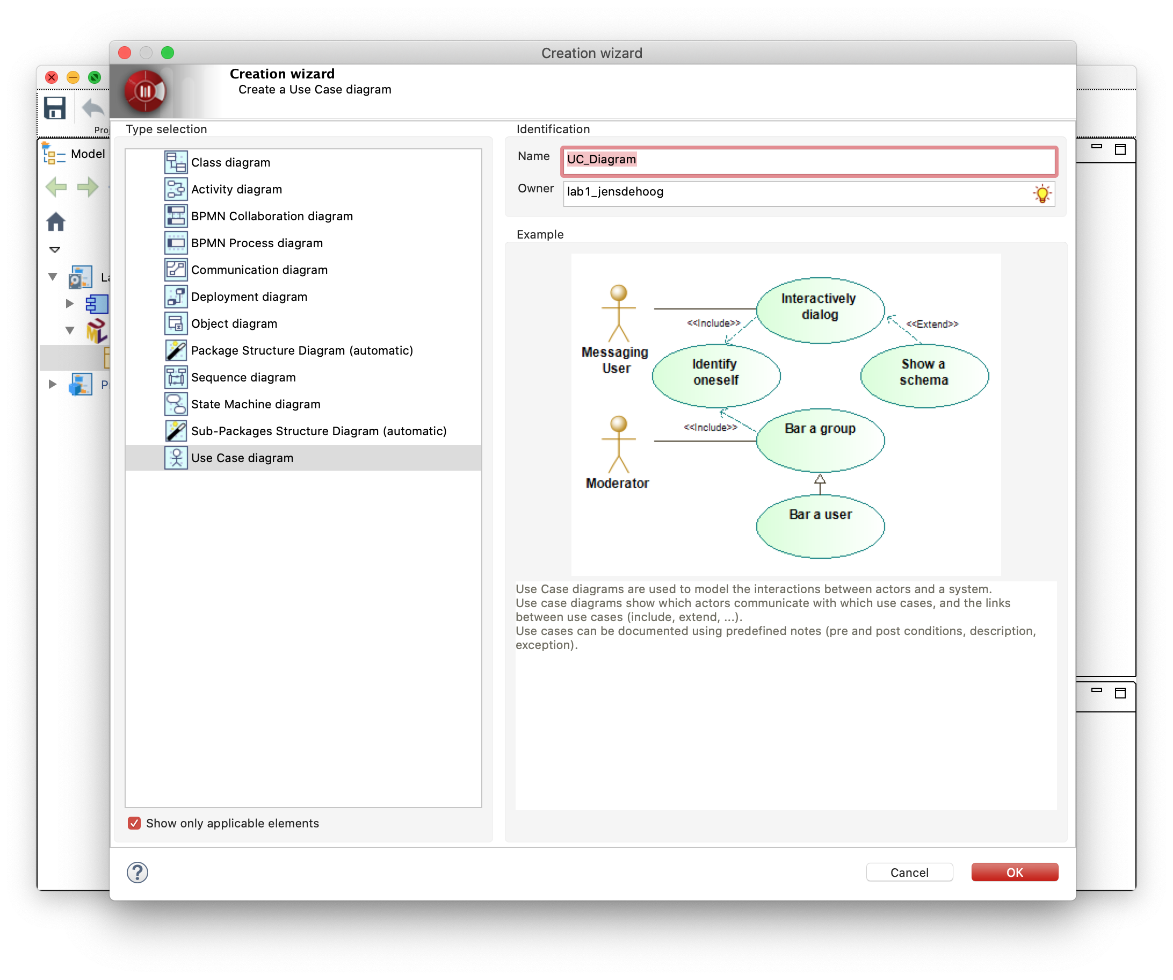
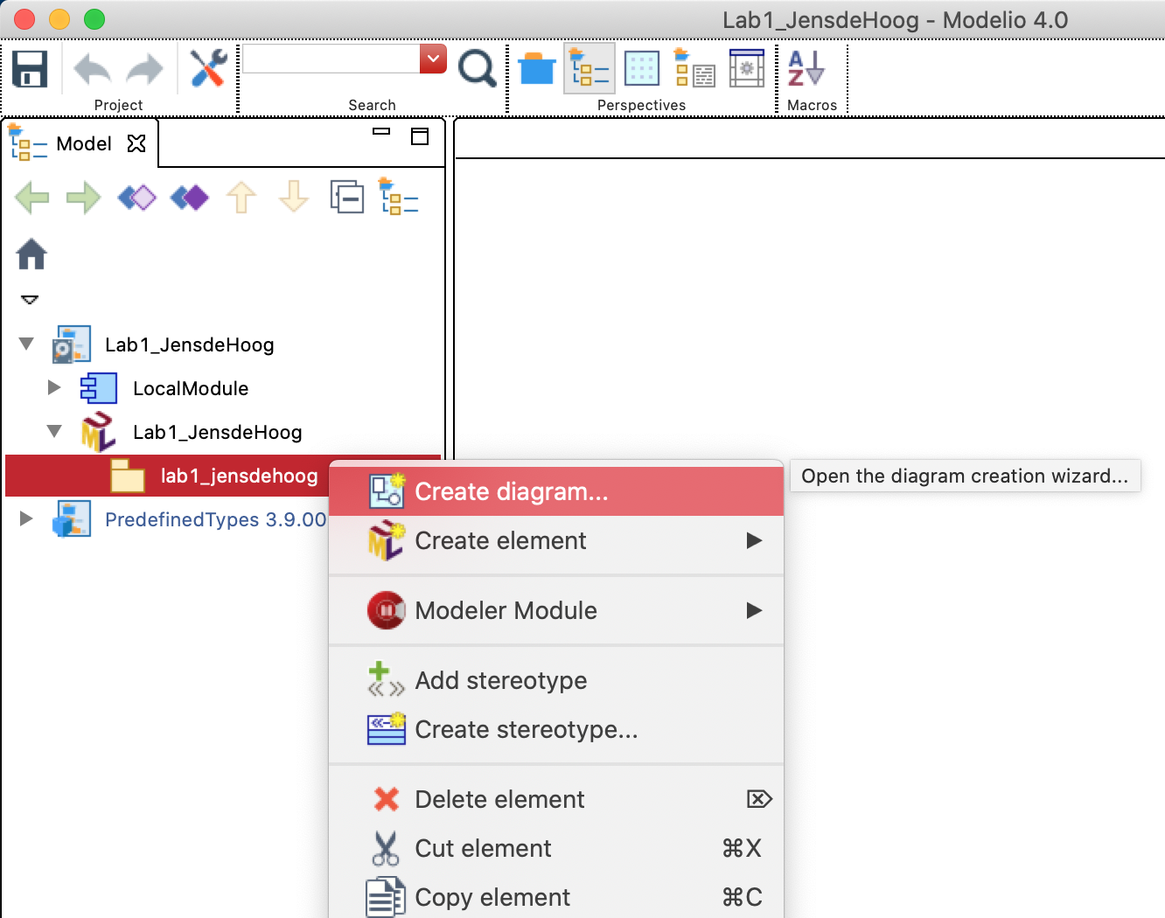
Usage of Modelio
Use case diagram

Slide 13
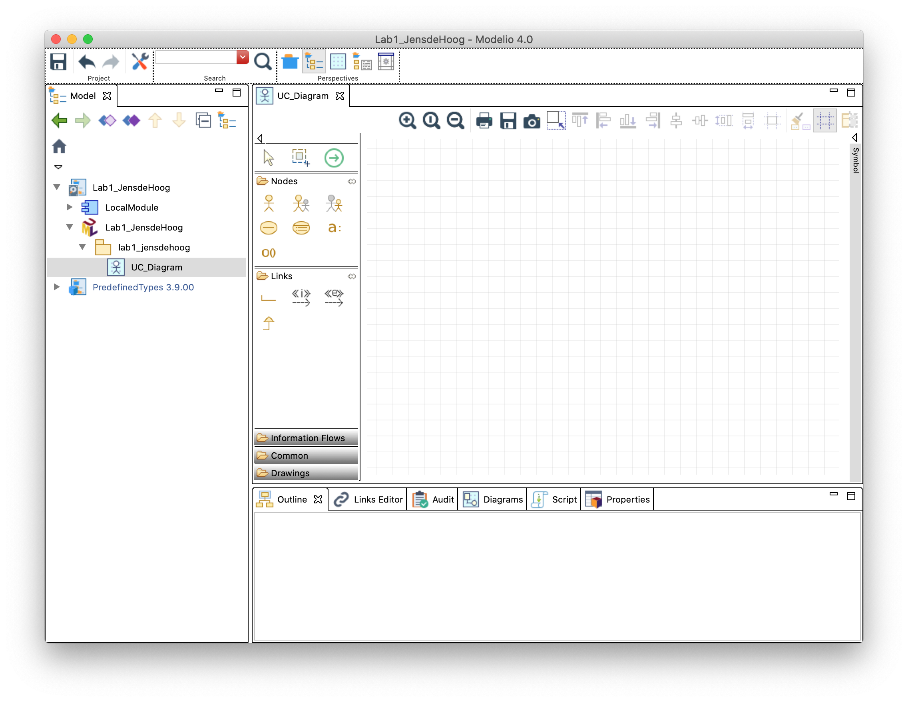
Usage of Modelio
Use case diagram

Slide 14
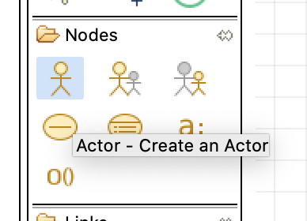
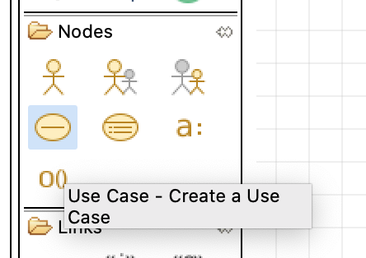
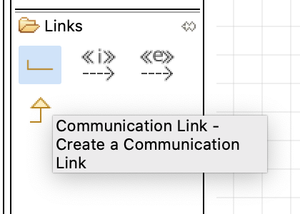
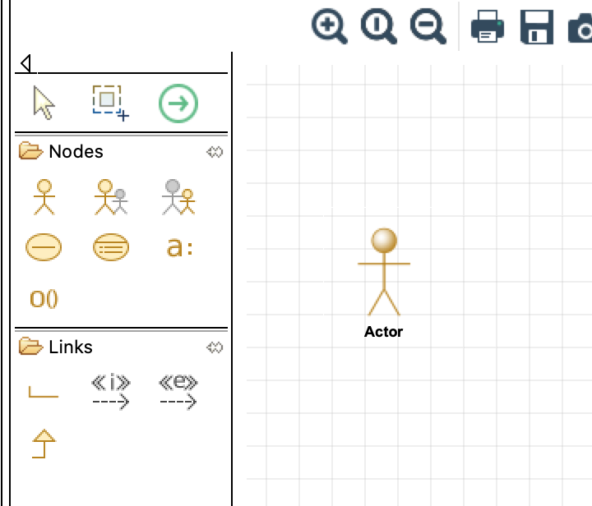
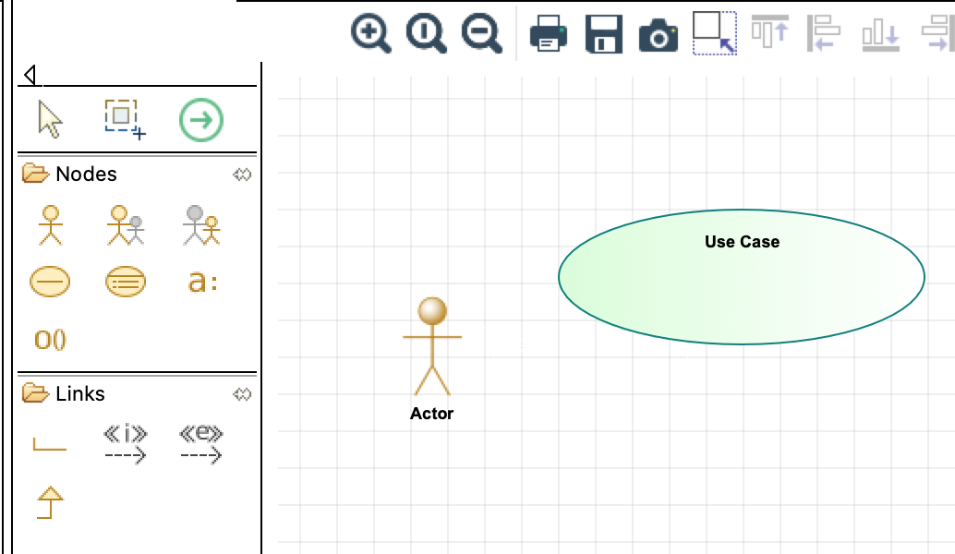
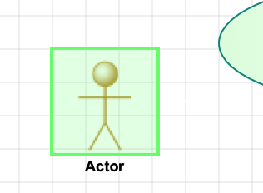
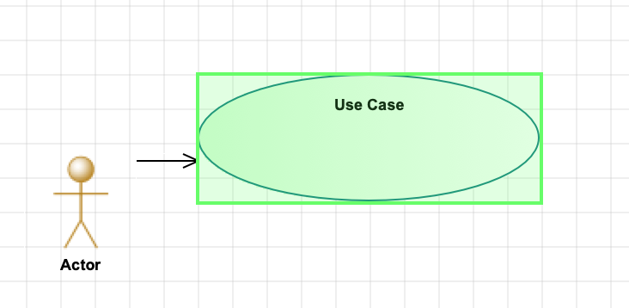
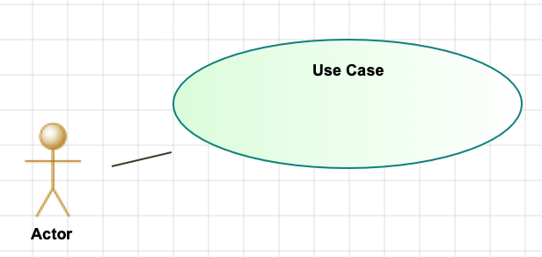
Usage of Modelio
Use case diagram
Add an actor
Add a use case
Add a relation
click
click

Slide 15
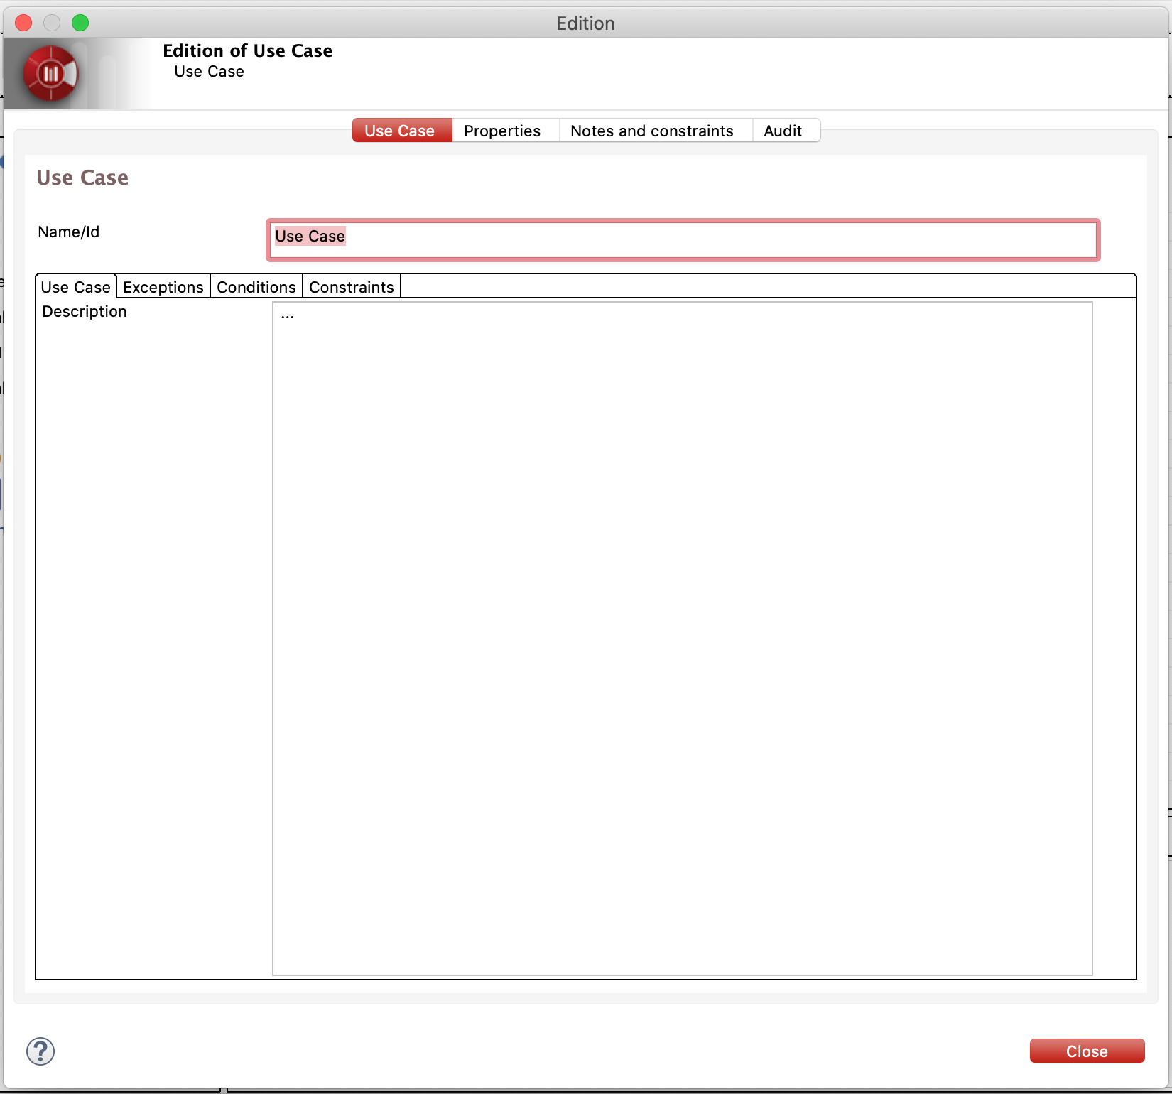
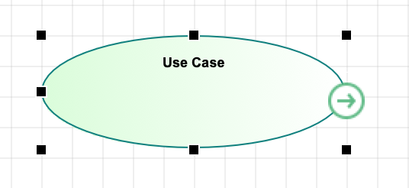
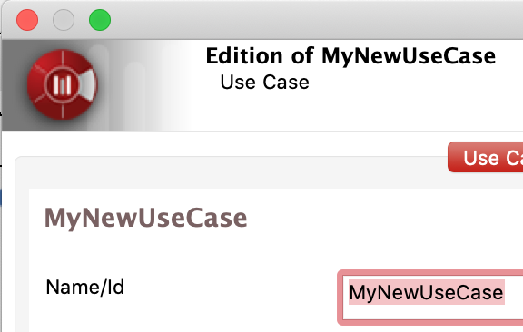
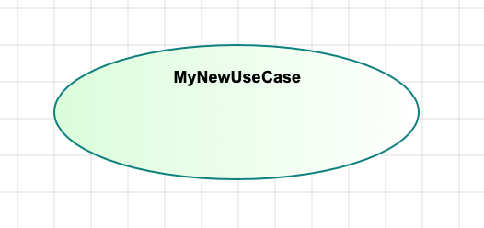
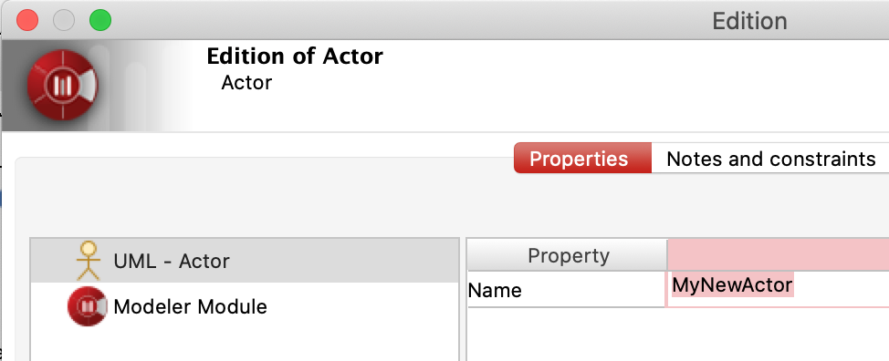
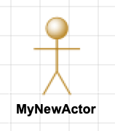
Usage of Modelio
Use case diagram
Changing names & parameters
+ [Enter]
Double click
Use Cases
Actors

Slide 16
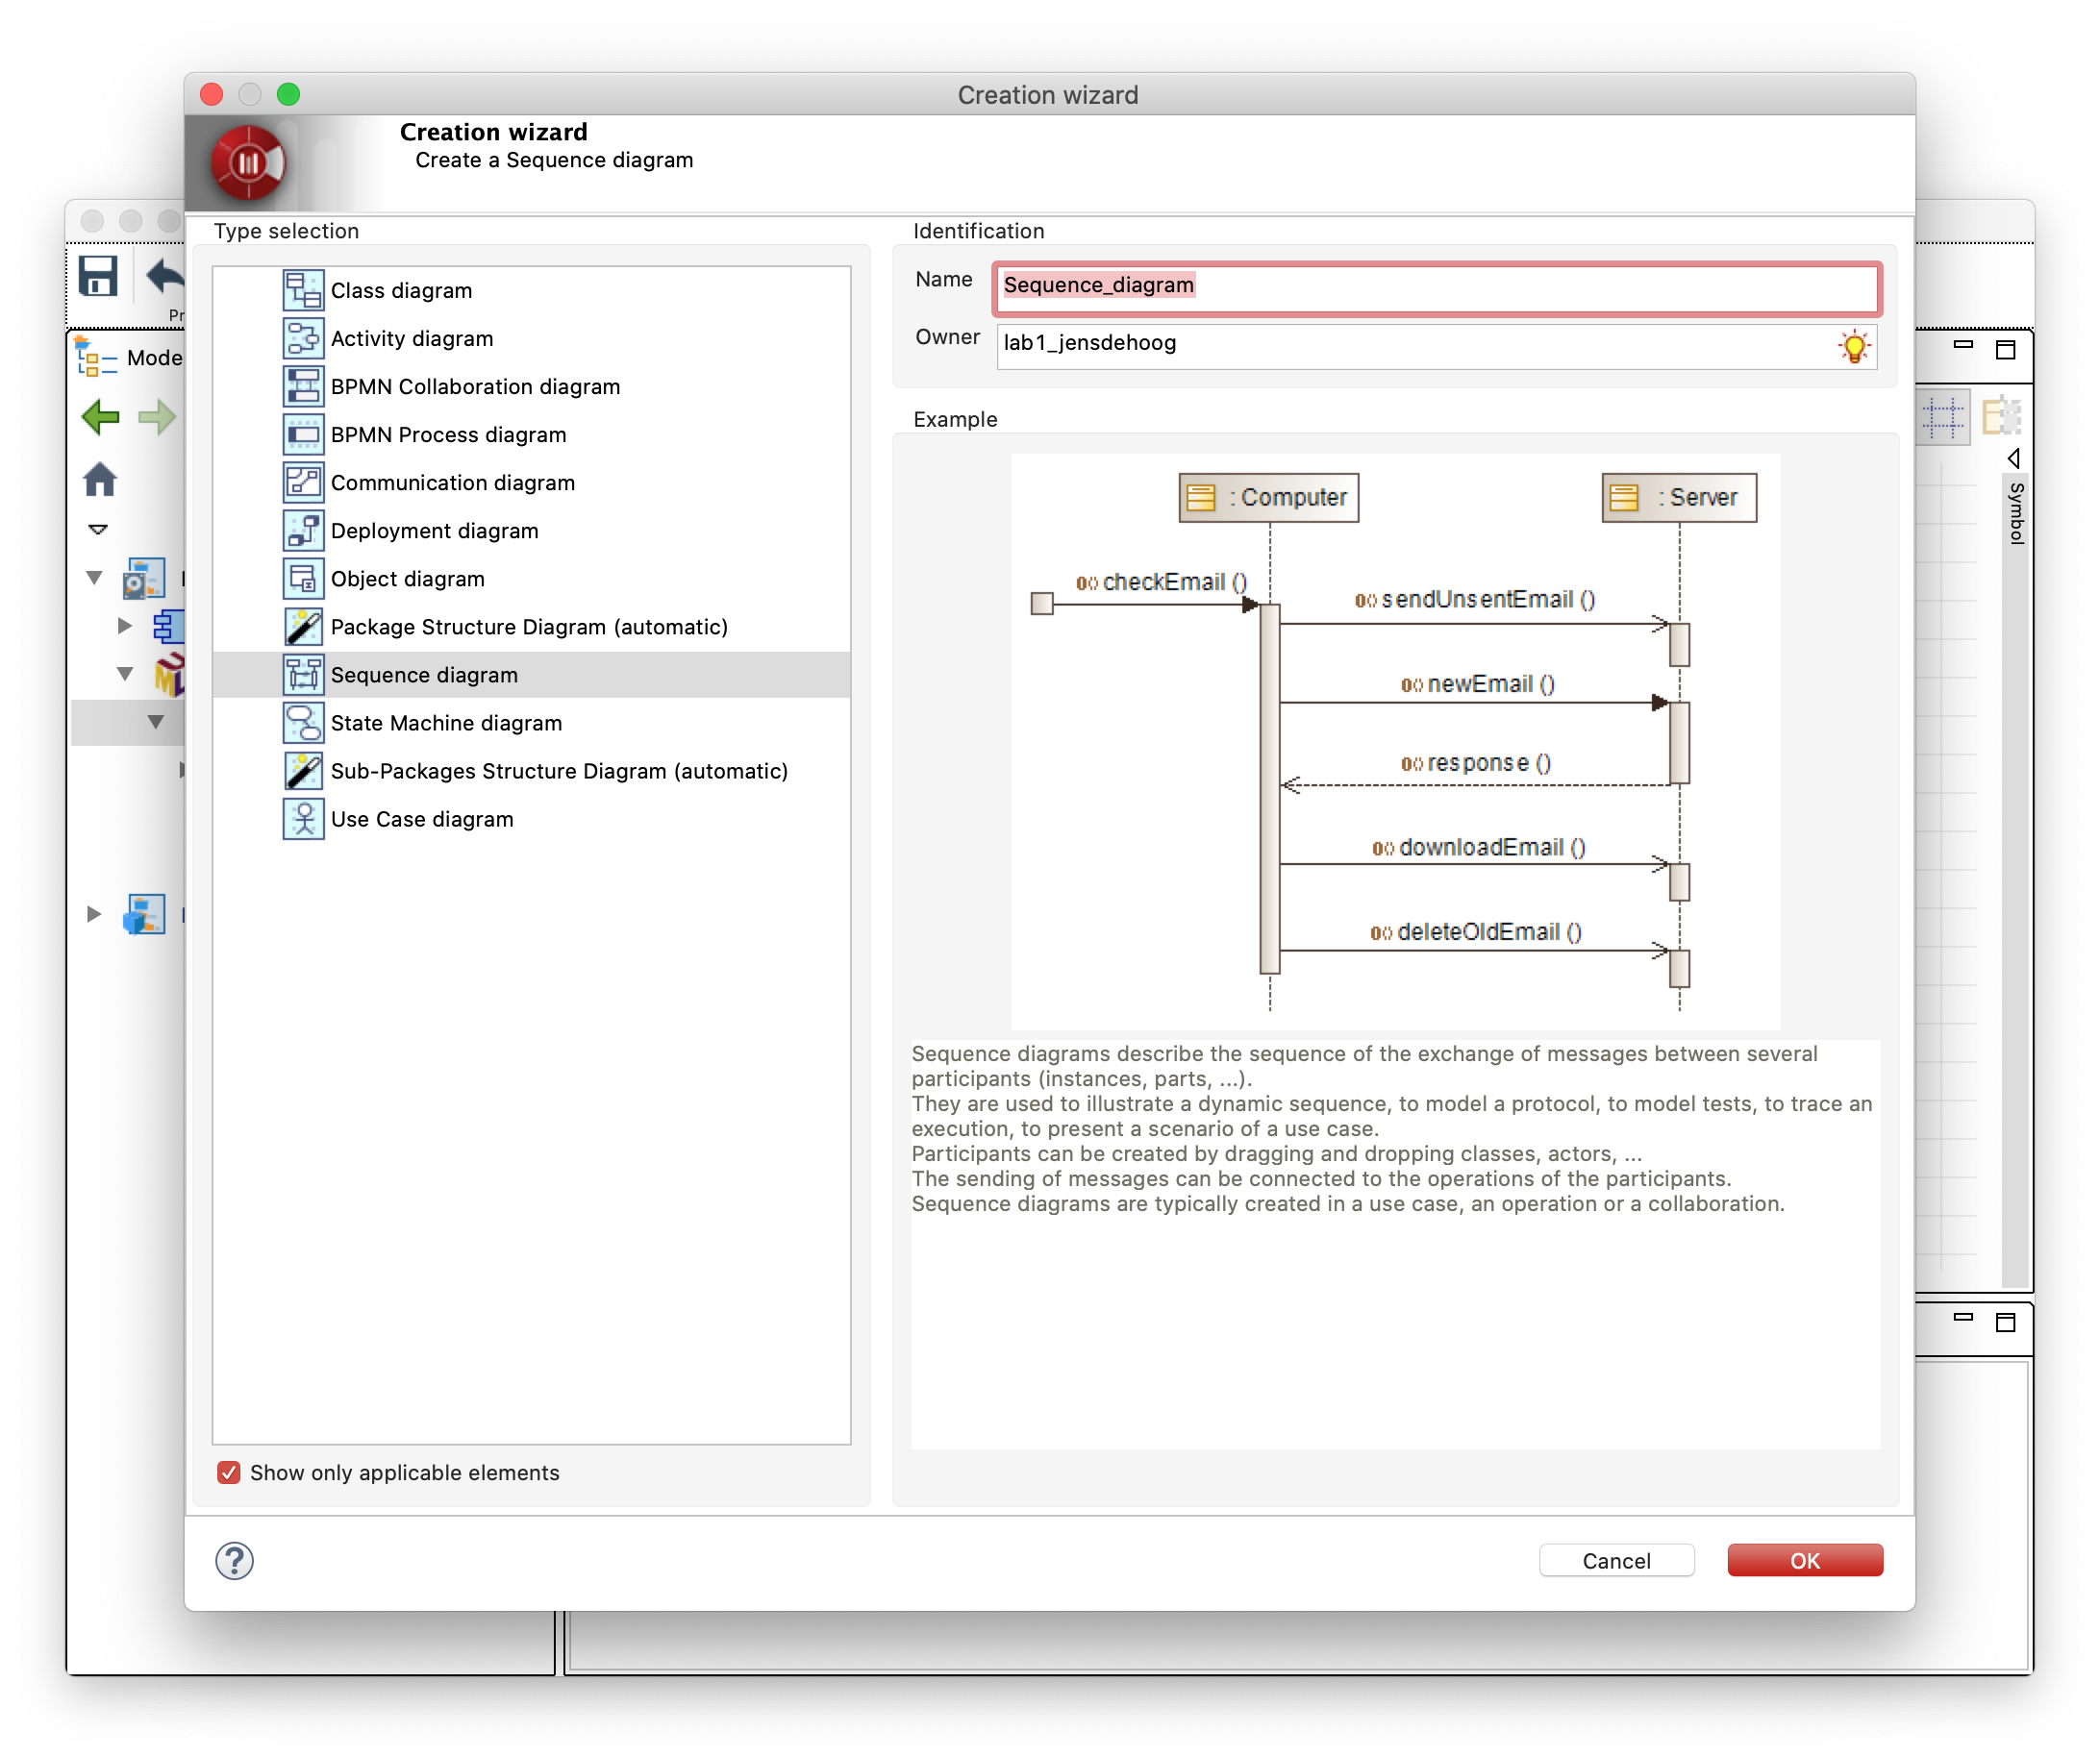
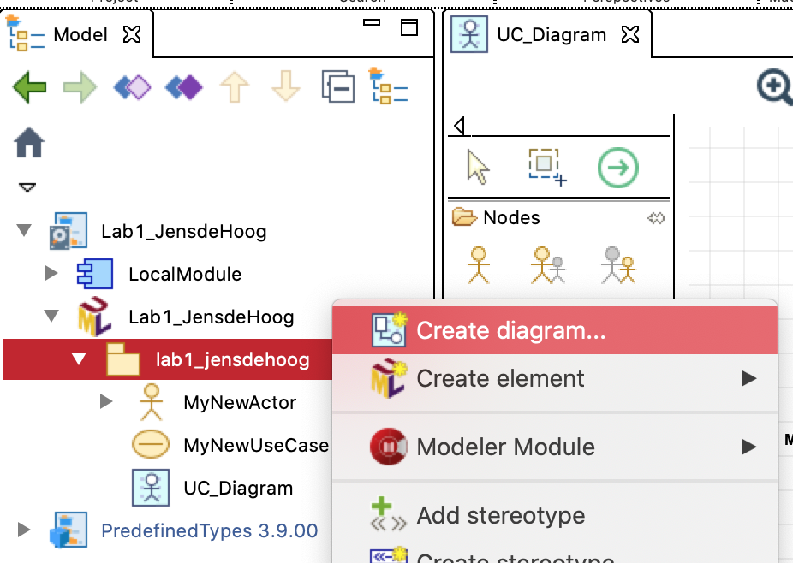
Usage of Modelio
Sequence diagram
Adding and changing components in same way as with use cases

Slide 17
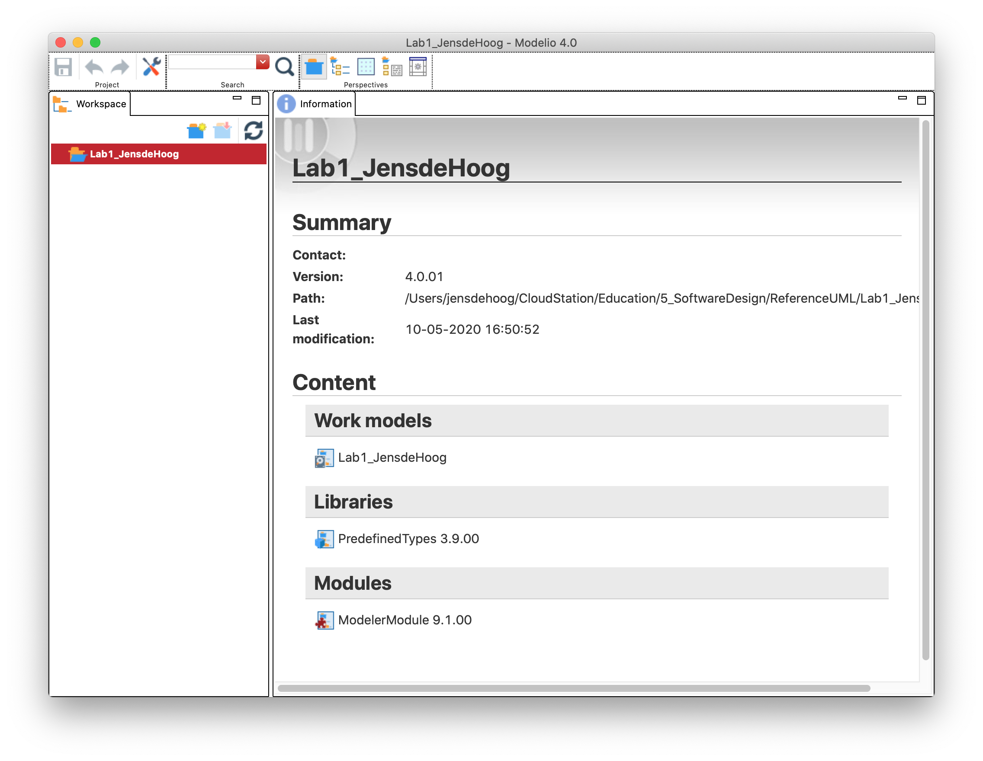
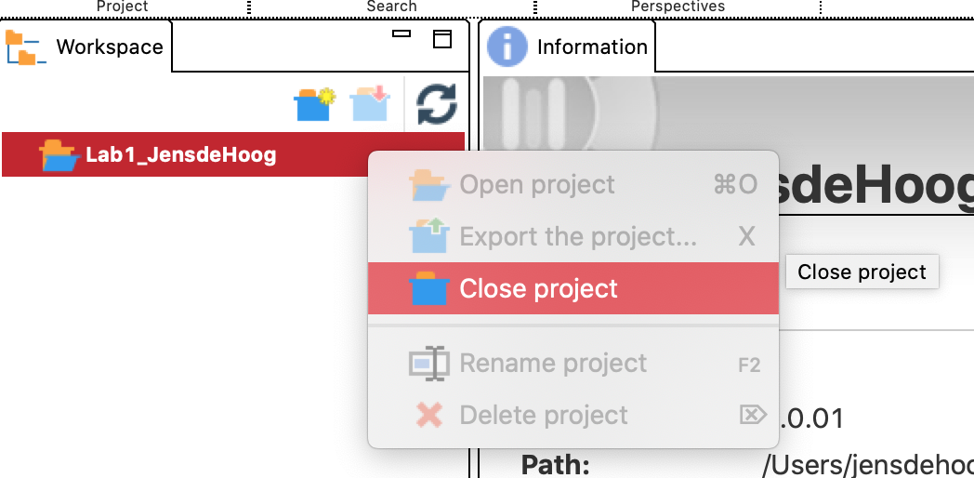
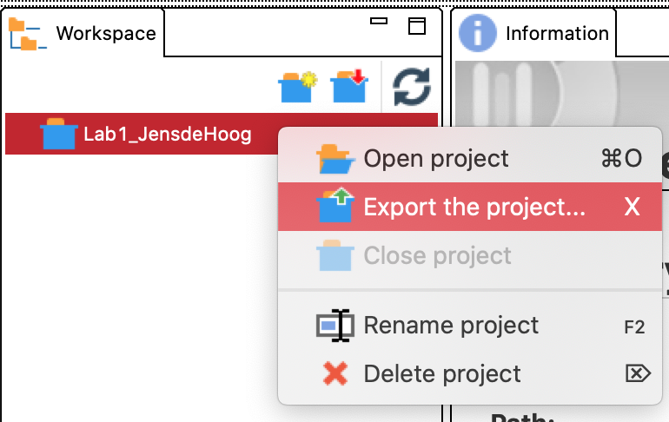
Usage of Modelio
Exporting projects
Right click
Right click

Slide 18
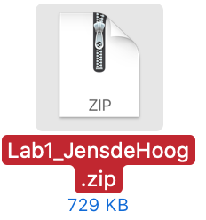

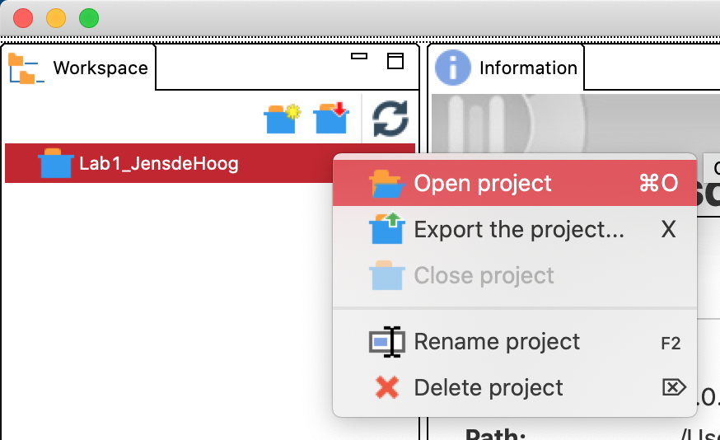
Usage of Modelio
Importing projects

Slide 19




Assignment
Simple motel booking system
…
Motel A
Two main features:
Find cheapest room in a motel for a given date
Book a room in a given motel on a given date
Motel B
Motel C

Slide 20
Assignment
Simple motel booking system
Goal
Given the code for checking available rooms ➞ create sequence diagram
Given the diagram for booking a room ➞ fill in the necessary code
Use Case Diagram of the features
Note the following extras:
Tests (both unit & integration)
Usage of Maven framework
In portfolio: one directory for this lab session ➞ Exported Modelio project ➞ Code exported in zip format

